Slide 1
A Presentation on Group Development,Cohessiveness,Team Performance,Decision Making
Submitted By:-
Chahat (11501173)
Divya(11501183)

Slide 2
Contents
Group Development
Cohesiveness
Team performance
Decision Making

Slide 3
What is Group?
Before we know about group development, we should know WHAT IS A GROUP??
A Group can be defined as two or more interacting and interdependent individuals who come together to achieve particular objectives.
A Group behavior can be stated as a course of action a group takes as a family. For example: Strike.
There are certain types in which group is divided in. Let’s know about them.

Slide 4
Types of Groups
There are two types of groups an individual forms.
Formal Groups
Informal Groups
Formal Groups:
These are the type of work groups created by the organization and have designated work assignments and rooted tasks. The behavior of such groups is directed toward achieving organizational goals. These can be further divided into two sub-groups.
Command group − It is a group consisting of individuals who report directly to the manager.
Interest group − It is a group formed by individuals working together to achieve a specific objective. Example − A group of workers working on a project and reporting to the same manager is considered as a command group. A group of friends chilling out together is considered as interest group or say members of a club.

Slide 5
Types of Groups(Continued……)
Informal Groups:
These groups are formed with friendships and common interests. These can be further classified into two sub-groups −
Task group − Those working together to finish a job or task is known as task group.
Friendship group − Those brought together because of their shared interests or common characteristics is known as friendship group.

Slide 6
Why Groups are needed?
The following points help us understand the need of joining a group by individuals −
Security mirrors strength in numbers. Status pinpoints a prestige that comes from belonging to a specific group. Inclusion in a group is considered as important because it provides recognition and status.
Self-esteem transmits people's feelings of self-worth. Membership can sometimes raise feelings of self-esteem like being accepted into a highly valued group.
Affiliation with groups can meet one's social needs. Work groups significantly contribute to meet the need for friendships and social relations.
Groups represent power. What mostly cannot be achieved individually becomes possible with group effort. Power might be aimed to protect themselves from unreasonable demands. Informal groups provide options for individuals to practice power.
People may join a group for goal achievement. Sometimes it takes more than one person to accomplish a particular task.

Slide 7
Why Group Development is important ?
It takes time, as each member brings unique personality traits, preferences, styles and experiences to the team.
They are able to produce quality work without significant friction.
Emphasis is strong toward accomplishment of team goals and members being focused on what is best for the team. Such changes in the makeup of a team, including the introduction of new, strong personalities, can bring a team back to the Forming stage.

Slide 8
Stages of Group Development
Forming:- This is where individuals come together for the first time, with the objective of working towards a common goal. It is critical at this time that team members get to know one another in order to remove barriers and learn about each other’s strengths and build trust.
Storming:-This is the most delicate stage of the team development process – where teams are most susceptible to failure or dissolution. That’s why a foundation of trust is so important.
Norming:- This stage marks the development of the team’s mission, values and goals. By establishing these agreed-upon norms, teams are able to set guidelines for appropriate and inappropriate behaviour.
Performing:- The performing stage is the most valuable to team success in a practice. At this stage, teams are ideally producing great results, working cohesively and optimizing each member’s strengths.
Adjourning:- This stage is undertaken after the completion of a particular task or objective. The group objectives should be fulfilled before adjournment. Leaders play a great role in the continuation and adjournment of the group.

Slide 9
WHAT IS GROUP COHESIVENESS?
Group cohesiveness (also called group cohesion and social cohesion) arises when bonds link members of a social group to one another and to the group as a whole. Although cohesion is a multi-faceted process, it can be broken down into four main components: social relations, task relations, perceived unity, and emotions.

Slide 10
ADVANTAGES AND DISADVANTAGES OF GROUP COHESIVENESS
ADVANTAGES
DISADVANTAGES
experience lower levels of stress
have lower rates of absenteeism
have lower turnover rates
experience greater job satisfaction and
have more consistent individual productivity outcomes within the group
Group allegiance to unsatisfactory leaders
Unrealistic or inadequate goals
Excessive competitiveness with others outside the group
Attenuation of critical judgments within the group that are necessary for course correction

Slide 11
TEAM PERFORMANCE
Team - A team is a dynamic system of interrelationships between a group of people, linked to a common purpose
Teams exist to produce results. The nature and measure of results vary from team to team, yet ultimately all teams are evaluated on their ability to produce results over time. Although there are times when a team must stay focused on the task, deadline and deliverables, the intensity of that focus is not sustainable.

Slide 12
Results of team performance
Expand leadership capacity and impact
Accelerate relationship and results
Engage in open and candid dialogue
Develop powerful terms of engagement
Build on collective strengths
Maximize team dynamics
Create a common vision and values

Slide 13
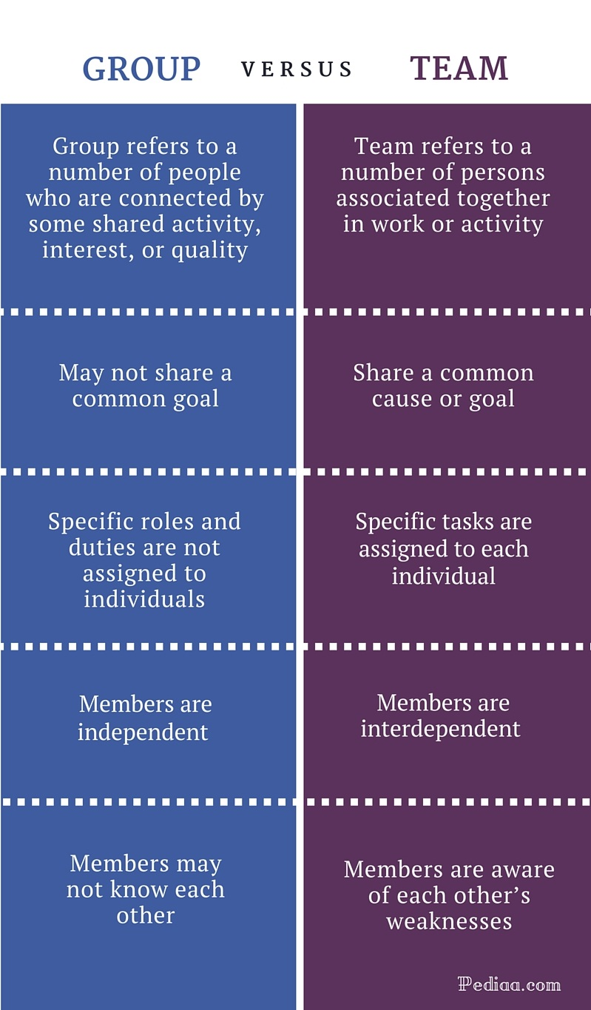

Slide 14
DECISION MAKING
The thought process of selecting a logical choice from the available options. When trying to make a good decision, a person must weight the positives and negatives of each option, and consider all the alternatives. For effective decision making, a person must be able to forecast the outcome of each option as well, and based on all these items, determine which option is the best for that particular situation.

Slide 15
STEPS OF DECISION MAKING
Identify the decision.- The first step in making the right decision is recognizing the problem or opportunity and deciding to address it. Determine why this decision will make a difference to your customers or fellow employees.
Gather information. Next, it’s time to gather information so that you can make a decision based on facts and data. This requires making a value judgment, determining what information is relevant to the decision at hand, along with how you can get it. Ask yourself what you need to know in order to make the right decision, then actively seek out anyone who needs to be involved.

Slide 16
Identify alternatives.-- Once you have a clear understanding of the issue, it’s time to identify the various solutions at your disposal. It’s likely that you have many different options when it comes to making your decision, so it is important to come up with a range of options. This helps you determine which course of action is the best way to achieve your objective.
Weigh the evidence.-- In this step, you’ll need to “evaluate for feasibility, acceptability and desirability” to know which alternative is best, according to management experts Phil Higson and Anthony Sturgess. Managers need to be able to weigh pros and cons, then select the option that has the highest chances of success. It may be helpful to seek out a trusted second opinion to gain a new perspective on the issue at hand.
Choose among alternatives.-- When it’s time to make your decision, be sure that you understand the risks involved with your chosen route. You may also choose a combination of alternatives now that you fully grasp all relevant information and potential risks.

Slide 17
Take action.-- Next, you’ll need to create a plan for implementation. This involves identifying what resources are required and gaining support from employees and stakeholders. Getting others onboard with your decision is a key component of executing your plan effectively, so be prepared to address any questions or concerns that may arise.
Review your decision. --An often-overlooked but important step in the decision making process is evaluating your decision for effectiveness. Ask yourself what you did well and what can be improved next time.

Slide 18
THANKYOU! ☺

